Slide 1
PHYS 5420 (M)
Classical Electrodynamics
Jan-Apr 2024

Slide 2
Tue 9 Jan | 1 | 01A: Intro to ED 02A: Electrostatics
Thu 11 Jan | 2 | 01C, 02C 03A: Boundary value problems

Slide 3
Class hours & venue
Tuesdays & Thursdays
12:30—14:15
SC L1

Slide 4

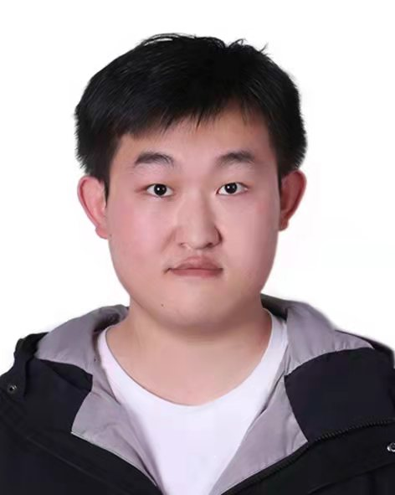
Instructors
Kenneth YOUNG
Room 211
LI Zhuochao
Room 313

Slide 5
Consultation time
Ask in class!
Discuss on e-platform!
Will not entertain individual consultation unless …
TA will have consultation hour

Slide 6
Course description /
Intended learning outcomes
Read it!

Slide 7
Pedagogy
(Semi)-flipped classroom
Brief lecture
Study on your own: videos + lecture notes
Discussion (next session)

Slide 8


Nature of electrodynamics
Elegant?
Messy?

Slide 9
eLearning
Blackboard

Slide 10
References
Pre-recorded videos (on Blackboard)
Lecture notes (on Blackboard)
Secondary references
  Jackson
  Landau & Lifshitz

Slide 11
Assessment
Participation | 10
Learning journal | 10
Homework | 10
Midterm | 25 (15 + 10)
Final | 45 (30 + 15)
 | 100

Slide 12
Some Preliminaries
Vectors and index notation
Cauchy integral theorem

Slide 13
Vectors and indices

Slide 14
Summation convention

Slide 15
Matrix multiplication

Slide 16
Kronecker delta

Slide 17
Identities

Slide 18
Levi-Civita Symbol

Slide 19
Cross product

Slide 20
Identities (1)
One repeated index

Slide 21
Identities (2)
Two repeated indices

Slide 22
Some Preliminaries
Vectors and index notation
Cauchy integral theorem

Slide 23

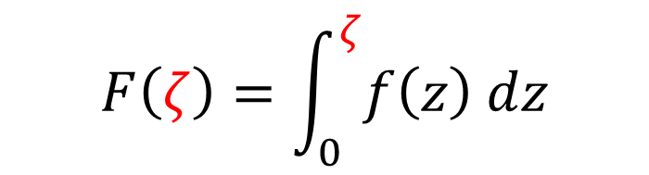
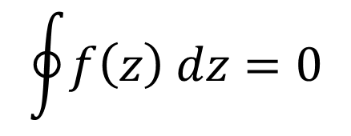




Integral independent of path?
$$F\left(ζ\right)=\int_{0}^{ζ}{f\left(z\right) dz}$$
$$ζ$$
$$γ_{2}$$
$$γ_{1}$$
$$γ=γ_{1}−γ_{2}$$
$$0$$
$$\oint{f\left(z\right) dz}=0$$
?

Slide 24

Independent of path?
Provided analytic everywhere inside the closed loop.
Prove in two steps:
Small rectangle
General closed loop
$$γ$$

Slide 25
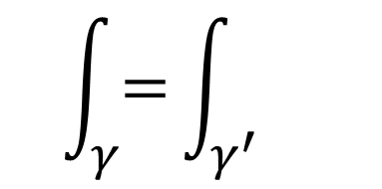




What if not analytic?
Pole at $ζ$
$$γ$$
$$γ^{′}$$
$$\int_{γ}{=}\int_{γ^{′}}{}$$
$$ζ$$

Slide 26


$$γ$$
$$γ$$
$$−γ^{′}$$
$$γ^{′}$$
$$γ^{′′}=γ−γ^{′}$$
$$ζ$$
$$ζ$$
analytic inside

Slide 27
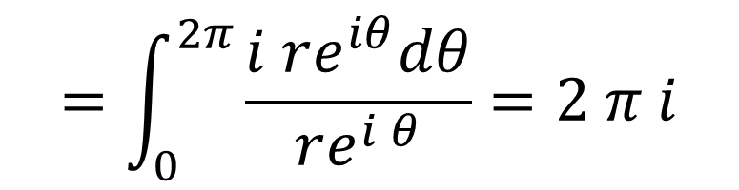





First-order pole
$$\oint{\frac{dz}{z−ζ}}$$
$$dz$$
$$=\int_{0}^{2π}{\frac{i re^{iθ}dθ}{re^{i θ}}}=2 π i$$
$$ζ$$
$$z−ζ=r e^{iθ}$$
$$dz=i r e^{iθ} dθ$$

Slide 28
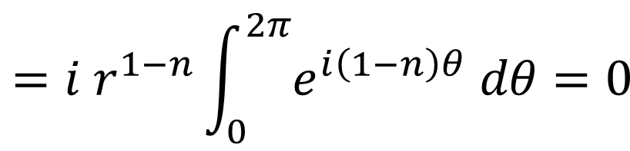
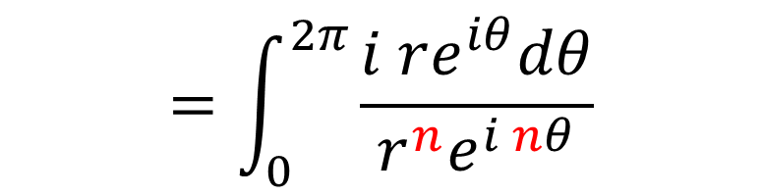




Higher-order pole
$$\oint{\frac{dz}{{\left(z−ζ\right)}^{n}}}$$
$$dr$$
$$=\int_{0}^{2π}{\frac{i re^{iθ}dθ}{r^{n}e^{i nθ}}}$$
$$ζ$$
$$=i r^{1−n}\int_{0}^{2π}{e^{i\left(1−n\right)θ} dθ=0}$$
$$z−ζ=r e^{iθ}$$
$$dz=i r e^{iθ} dθ$$

Slide 29
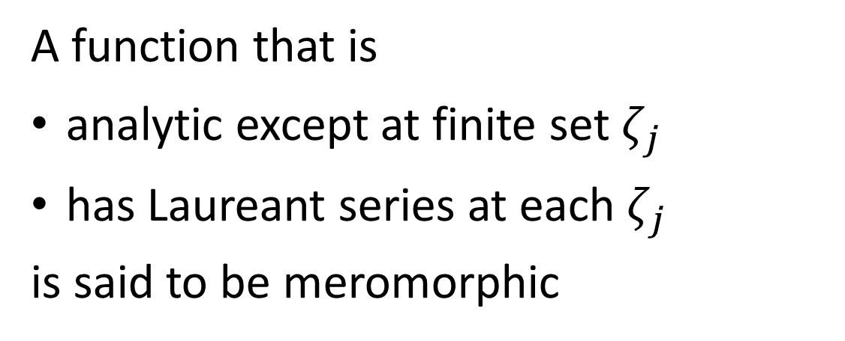
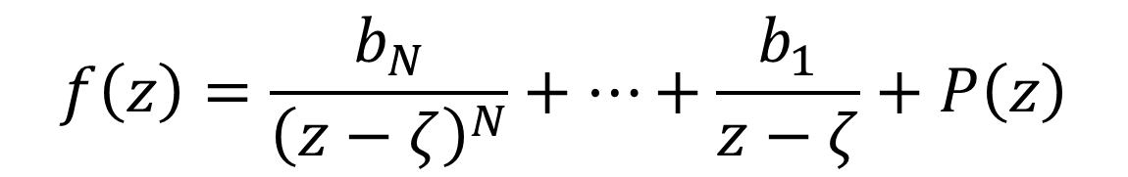
Laureant series
$$f\left(z\right)=\frac{b_{N}}{{\left(z−ζ\right)}^{N}}+…+\frac{b_{1}}{z−ζ}+P\left(z\right)$$
power series
A function that is
analytic except at finite set $ζ_{j}$
has Laureant series at each $ζ_{j}$
is said to be meromorphic

Slide 30

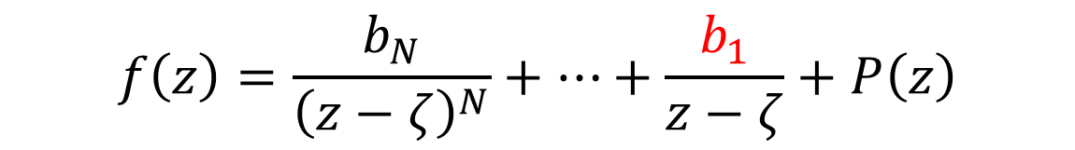


Integral around a pole
$$f\left(z\right)=\frac{b_{N}}{{\left(z−ζ\right)}^{N}}+…+\frac{b_{1}}{z−ζ}+P\left(z\right)$$
$$\oint{f\left(z\right) dz=2π i b_{1}}$$
$$\frac{1}{2π i}\oint{f\left(z\right) dz}=Res (ζ)$$
$$ζ$$

Slide 31





If $f(z)$ analytic on $γ$ and inside
$$f\left(ζ\right)=\frac{1}{ 2π i} \oint{\frac{f\left(z\right)}{z−ζ} dz}$$
$$dz$$
$$z$$
$$ζ$$
Boundary determines interior

Slide 32
Reference
http://www.phy.cuhk.edu.hk/elearning/year1phy/

